Slide 1
Wireless IOT 2IOT
Lora Lab RPI

Slide 2
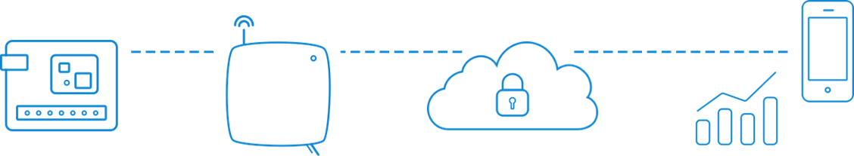
The Things Network
The Things Network is about enabling low power Devices to use long range Gateways to connect to an open-source, decentralized Network to exchange data with Applications.

Slide 3
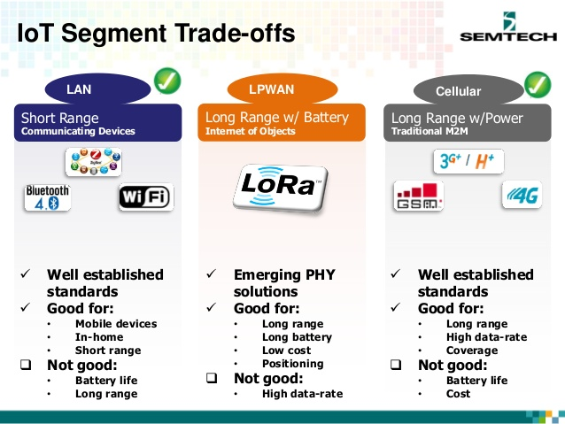
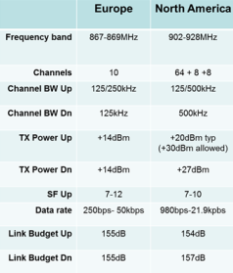
LoRa: Properties

Slide 4


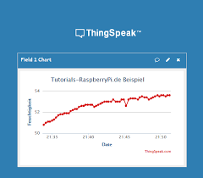

Devices and Gateways
TCP/IP
TCP/IP
TCP/IP
TCP/IP
TTN Indoor Gateway (8ch)
RPi + Dragino Gateway (1ch)
TCP/IP
TCP/IP
Client
(PC)
Server
(cloud)
Arduino MKR WAN 1310
RPi + RFM95W

Slide 5
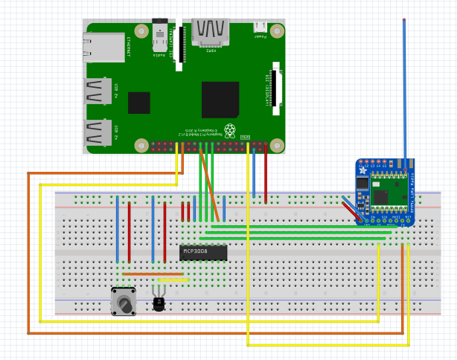
Setup: RPi, Analog in, LM35, MCP3008, RFM95W LoRa

Slide 6
Preparations (details see next slides)
Install RFM95W on RPi:
CircuitPython (Blinka), SPI, TinyLoRa
Create an account on TTN: link
Register a device on TTN: link
Use ABP: Activation By Personalization
Find keys to use in Python code:
Device Address, Network Session Key, App Session Key
Run code (see further) on RPi and check data
Decode payload:

Slide 7
Decoder
// TinyLoRa Decoder
function Decoder(bytes, port) {
var decoded = {};
// Decode bytes to int
var voltInt = (bytes[0] << 8) | bytes[1];
var tempInt = (bytes[2] << 8) | bytes[3];
// Decode int to float
decoded.volt = voltInt / 100;
decoded.temp = tempInt / 100;
return {
field1: decoded.volt,
field2: decoded.temp
}
}

Slide 8
Update your Pi and Python
Run the standard updates:
sudo apt-get update
sudo apt-get upgrade (probably not necessary on a fresh image, can take a lot of time)
sudo pip3 install --upgrade setuptools
If above doesn't work try
sudo apt-get install python3-pip
Notes:
On Pi5: create virtual environment
sudo apt install python3-venv
python3 -m venv blinka-env --system-site-packages
source blinka-env/bin/activate
(deactivate)

Slide 9
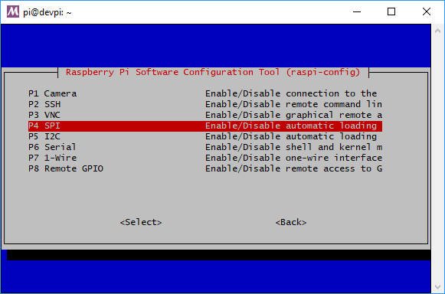
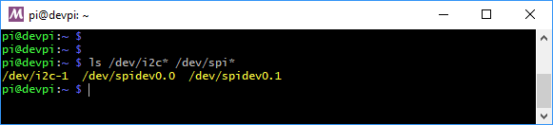
Enable SPI
Run raspi-config and enable SPI
sudo raspi-config
Once SPI enabled, verify you have the SPI devices with the command
ls /dev/spi*
You should see the response
/dev/spidev0.0 /dev/spidev0.1

Slide 10
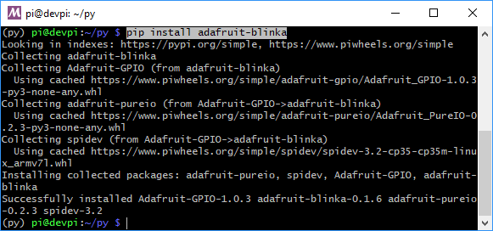
Install Python libraries
Run the following command to install adafruit_blinka (CircuitPython)
pip3 install adafruit-blinka
The computer will install a few different libraries such as adafruit-pureio (our ioctl-only i2c library), spidev (for SPI interfacing), Adafruit-GPIO (for detecting your board) and of course adafruit-blinka

Slide 11
Install required CircuitPython Libraries
Run the following command from your terminal to install the Adafruit_CircuitPython_TinyLoRa library to communicate with the RFM9x breakout board
sudo pip3 install adafruit-circuitpython-tinylora==2.2.6

Slide 12
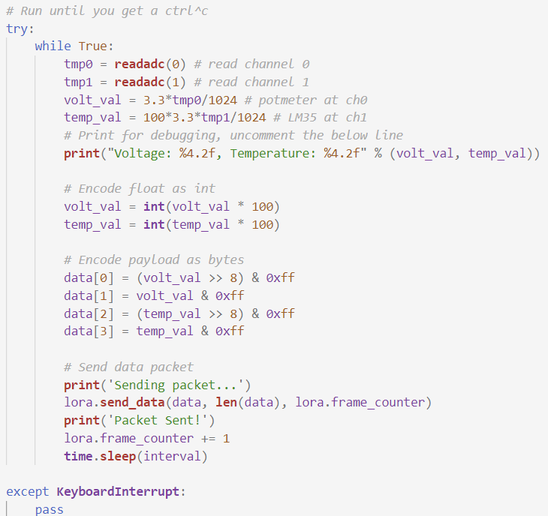
Python code: TTN transmitter
Install, configure (keys) and run the TTN transmitter Python program

Slide 13
Python code: TTN transmitter
import time
import RPi.GPIO as GPIO
import busio
import digitalio
import board
from adafruit_bus_device.spi_device import SPIDevice
from adafruit_tinylora.adafruit_tinylora import TTN, TinyLoRa
interval = 15 # Sample period in seconds
GPIO.setmode(GPIO.BCM) # use GPIO numbers
# Initialize SPI bus
spi = busio.SPI(board.SCK, MOSI=board.MOSI, MISO=board.MISO)
# Initialize control pins for adc
cs0 = digitalio.DigitalInOut(board.CE0) # chip select CE0 for adc; alternatively use e.g. Dxx (=GPIOxx)
adc = SPIDevice(spi, cs0, baudrate= 1000000)
# RFM9x Breakout Pinouts
cs = digitalio.DigitalInOut(board.D5)
irq = digitalio.DigitalInOut(board.D6)
rst = digitalio.DigitalInOut(board.D4)
# TTN Device Address, 4 Bytes, MSB
devaddr = bytearray([0x00, 0x00, 0x00, 0x00])
# TTN Network Key, 16 Bytes, MSB
nwkey = bytearray([0x00, 0x00, 0x00, 0x00, 0x00, 0x00, 0x00, 0x00, 0x00, 0x00, 0x00, 0x00, 0x00, 0x00, 0x00, 0x00])
# TTN Application Key, 16 Bytess, MSB
app = bytearray([0x00, 0x00, 0x00, 0x00, 0x00, 0x00, 0x00, 0x00, 0x00, 0x00, 0x00, 0x00, 0x00, 0x00, 0x00, 0x00])
ttn_config = TTN(devaddr, nwkey, app, country='EU')
lora = TinyLoRa(spi, cs, irq, rst, ttn_config, channel=0)
# Data Packet to send to TTN
data = bytearray(4)
# read SPI data 8 possible adc's (0 thru 7)
def readadc(adcnum):
if ((adcnum > 7) or (adcnum < 0)):
return -1
with adc:
r = bytearray(3)
spi.write_readinto([1,(8+adcnum)<<4,0], r)
time.sleep(0.000005)
adcout = ((r[1]&3) << 8) + r[2]
return adcout
# Run until you get a ctrl^c
try:
while True:
tmp0 = readadc(0) # read channel 0
tmp1 = readadc(1) # read channel 1
volt_val = 3.3*tmp0/1024 # potmeter at ch0
temp_val = 100*3.3*tmp1/1024 # LM35 at ch1
# Print for debugging, uncomment the below line
print("Voltage: %4.2f, Temperature: %4.2f" % (volt_val, temp_val))
# Encode float as int
volt_val = int(volt_val * 100)
temp_val = int(temp_val * 100)
# Encode payload as bytes
data[0] = (volt_val >> 8) & 0xff
data[1] = volt_val & 0xff
data[2] = (temp_val >> 8) & 0xff
data[3] = temp_val & 0xff
# Send data packet
print('Sending packet...')
lora.send_data(data, len(data), lora.frame_counter)
print('Packet Sent!')
lora.frame_counter += 1
time.sleep(interval)
except KeyboardInterrupt:
pass

Slide 14
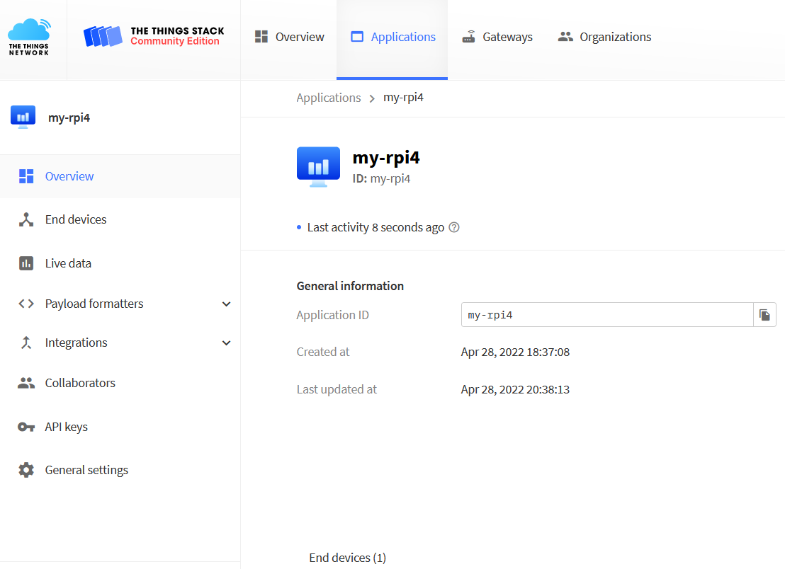
Create an application

Slide 15
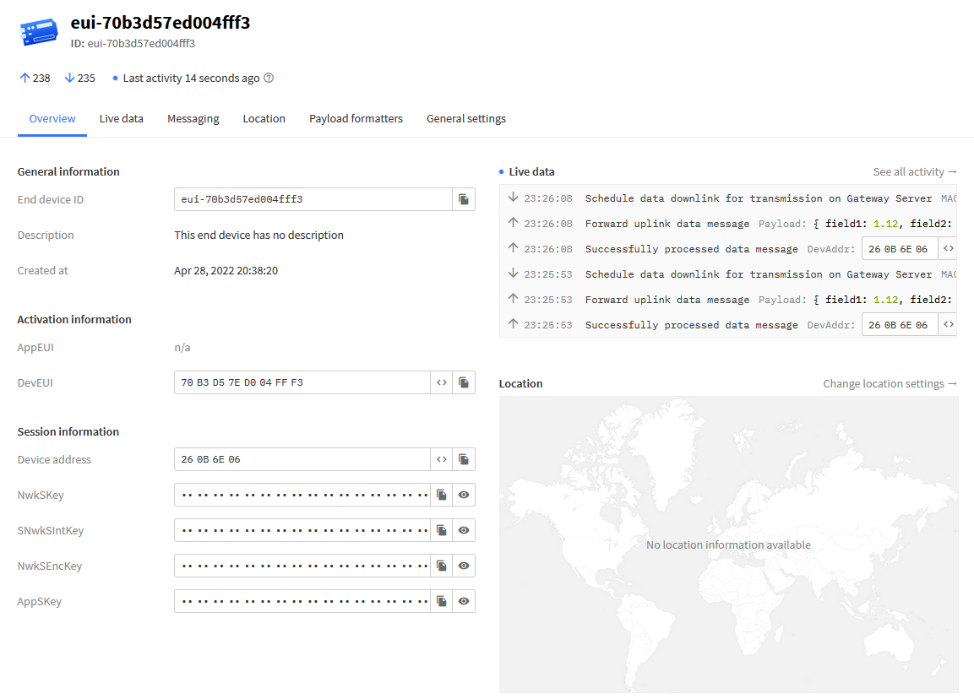
Create an end device

Slide 16
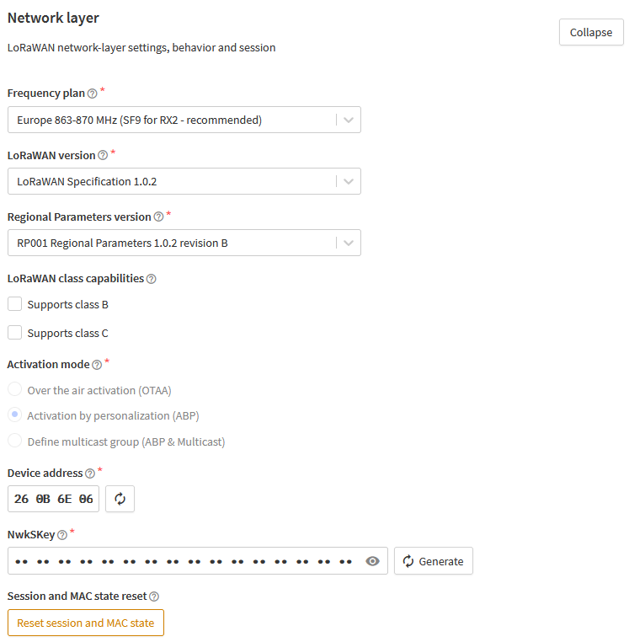
End device Network layer
Use reset to receive data after making changes

Slide 17
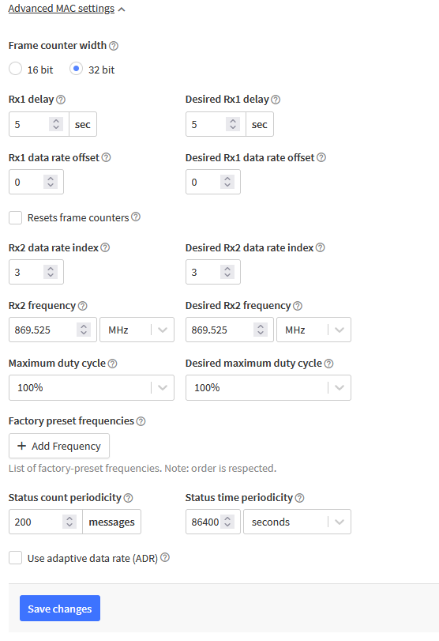
End device Advanced MAC settings

Slide 18
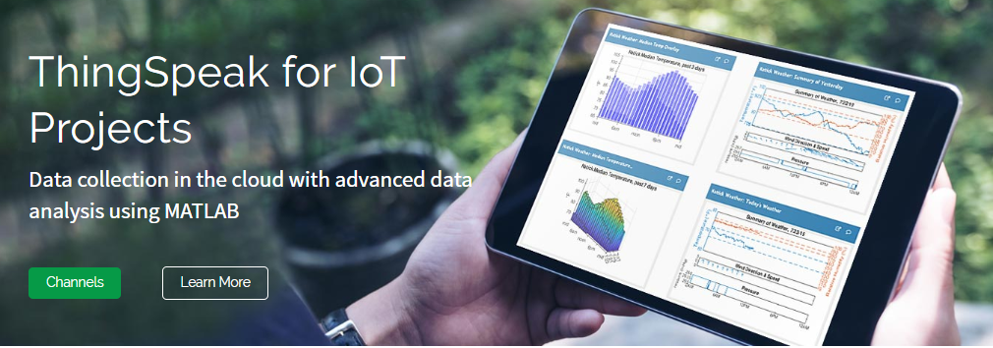
ThingSpeak TTN integration
ThingSpeak: https://thingspeak.com/
ThingSpeak - integrations: https://www.thethingsindustries.com/docs/integrations/

Slide 19
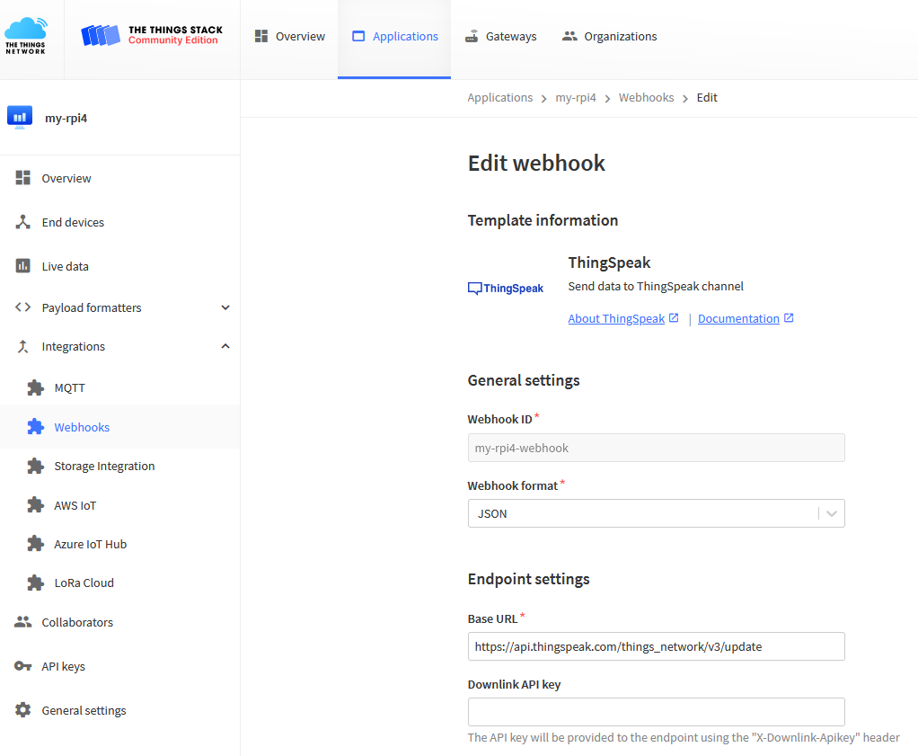
ThingSpeak TTN integration

